Slide 1
Mental set
Introduction to area and unit squares
https://www.youtube.com/watch?v=A7zPgMV4eTM
Notes:
hook

Slide 2
24
7
30
Date
Topic : Measurement
Topic : Measurement
EQ – What do I know about Measurement from previous years?
5
Notes:
Lesson objective (EQ)

Slide 3

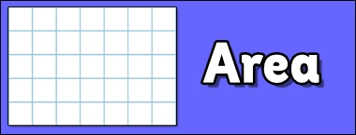
Lesson Objective
By the end of this lesson you will be able to;
Convert between metric units of length
Calculate areas of parallelogram (including rectangle and square), triangle and circle.
Calculate areas of composite shapes.
Notes:
Lesson

Slide 4
Success Criteria
You will know you are successful in achieving the objective by…
You will be able to convert between units of length in metric system.
Calculate areas of simple shapes like, rectangle, square, triangle and circle
Calculate areas of composite shapes by adding and subtracting simpler shapes.

Slide 5
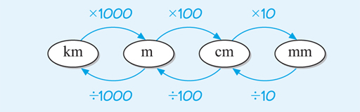
24
7
30
Date
Topic : Measurement
EQ – What do I know about Measurement from previous years?
How do I convert between units of length?
5
Notes:
Input

Slide 6
Check for understanding
30 mm = ______ cm
120 cm = ______ m
13 km = _______ m
560 mm = ______m
1200 m = ______ km
3 km =_________m
1.35 m = _______mm
Notes:
Check for understanding

Slide 7
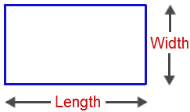
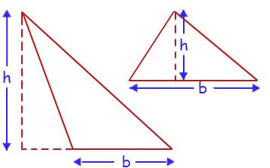
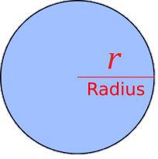
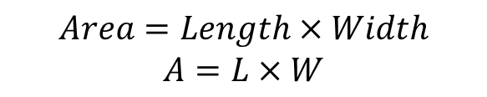
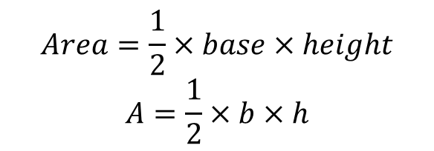
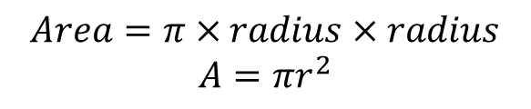
24
7
30
Date
Topic : Measurement
EQ – What do I know about Measurement from previous years?
How do I calculate area of a rectangle?
$$Area=Length×Width$$
$$A=L×W$$
How do I calculate area of a triangle?
$$Area=\frac{1}{2}×base×height$$
$$A=\frac{1}{2}×b×h$$
How do I calculate area of a circle?
$$Area=π×radius×radius$$
$$A=πr^{2}$$
5
Notes:
Input

Slide 8
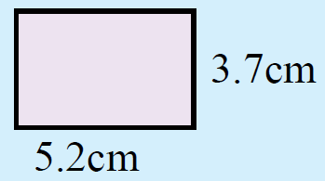
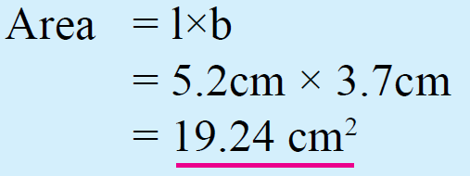
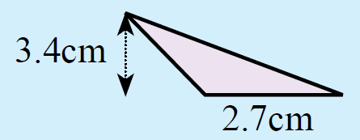
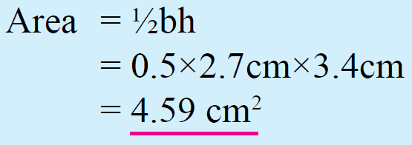
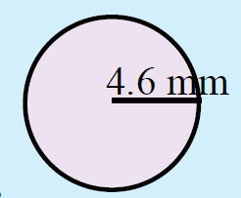
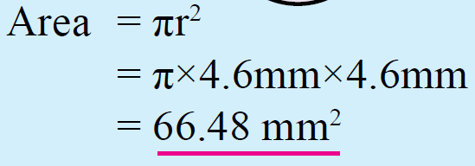
Guided Practice
A)
B)
C)
Notes:
Guided practice

Slide 9
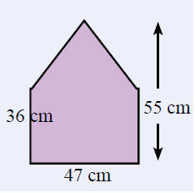

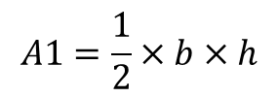
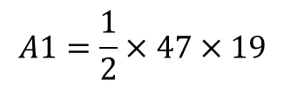


24
7
30
Topic : Measurement
EQ –What do I know about Measurement from previous years?
How do you find the area of composite shape?
Step 1 : Break the composite shape into smaller Parts
Step 2 : Find the area of each part
A1
Rectangle – A2
$$A2=L×W$$
$$=47×36=1692 cm^{2}$$
A2
Triangle – A1
$$A1=\frac{1}{2}×b×h$$
b = 47 cm
h = 55 – 36 = 19 cm
$$A1=\frac{1}{2}×47×19$$
$$=446.5 cm^{2}$$
Step 3 : Add the areas
Total Area (A) =
A1 + A2 =
1692 + 446.5 =
2138.5 cm²

Slide 10
Activity
Dr Dwyer Textbook, page 34, Exercise 3.1
Notes:
Independent practice

Slide 11
Closure activity
Review Success Criteria
Notes:
Closure

